Slide 1
Chapter 5:
The Selection Structure

Slide 2
Objectives
Include the selection structure in pseudocode and in a flowchart
Code a selection structure using the if statement
Include comparison operators in a selection structure’s condition
Include logical operators in a selection structure’s condition
Temporarily convert a character to either uppercase or lowercase
Format numeric output

Slide 3
Making Decisions
With only the sequence structure, all instructions are executed in order
A selection structure is needed when a decision must be made (based on some condition) before selecting an instruction to execute
A selection structure’s condition must be phrased as a Boolean expression (evaluates to true or false)

Slide 4
Making Decisions (cont’d.)
Single-alternative selection structure
Set of instructions is executed only if condition evaluates to true
Dual-alternative selection structure
Executes different sets of instructions based on whether condition evaluates to true or false
True path
Instructions followed when condition evaluates to true
False path
Instructions followed when condition evaluates to false

Slide 5
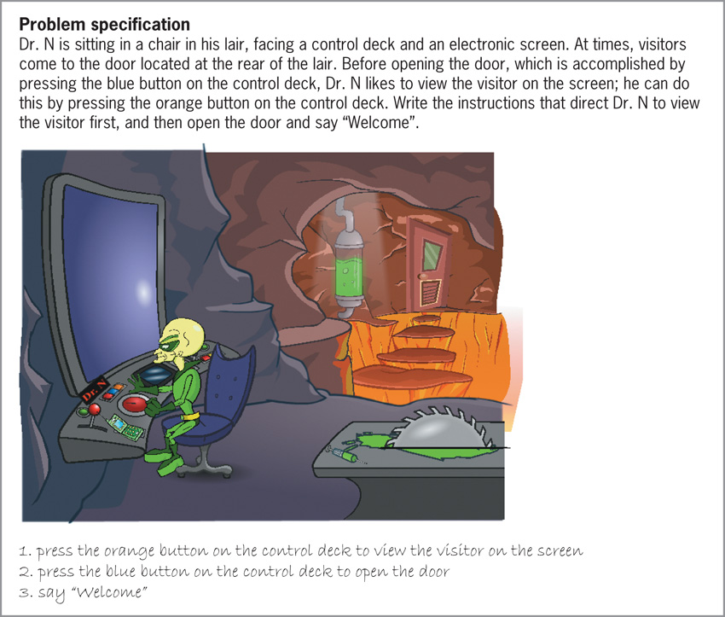
Making Decisions (cont’d.)
Figure 5-1 A problem that requires
the sequence structure only

Slide 6
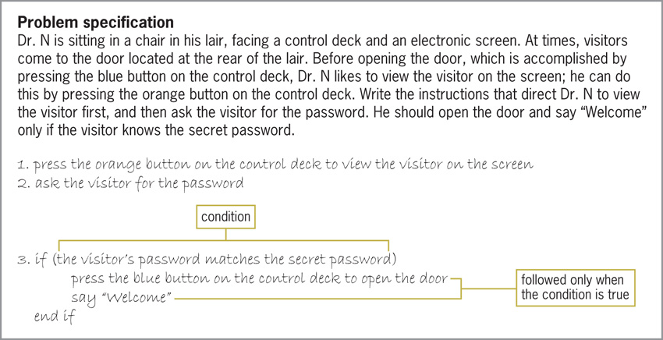
Making Decisions (cont’d.)
Figure 5-2 A problem that requires the sequence structure
and a single-alternative selection structure

Slide 7
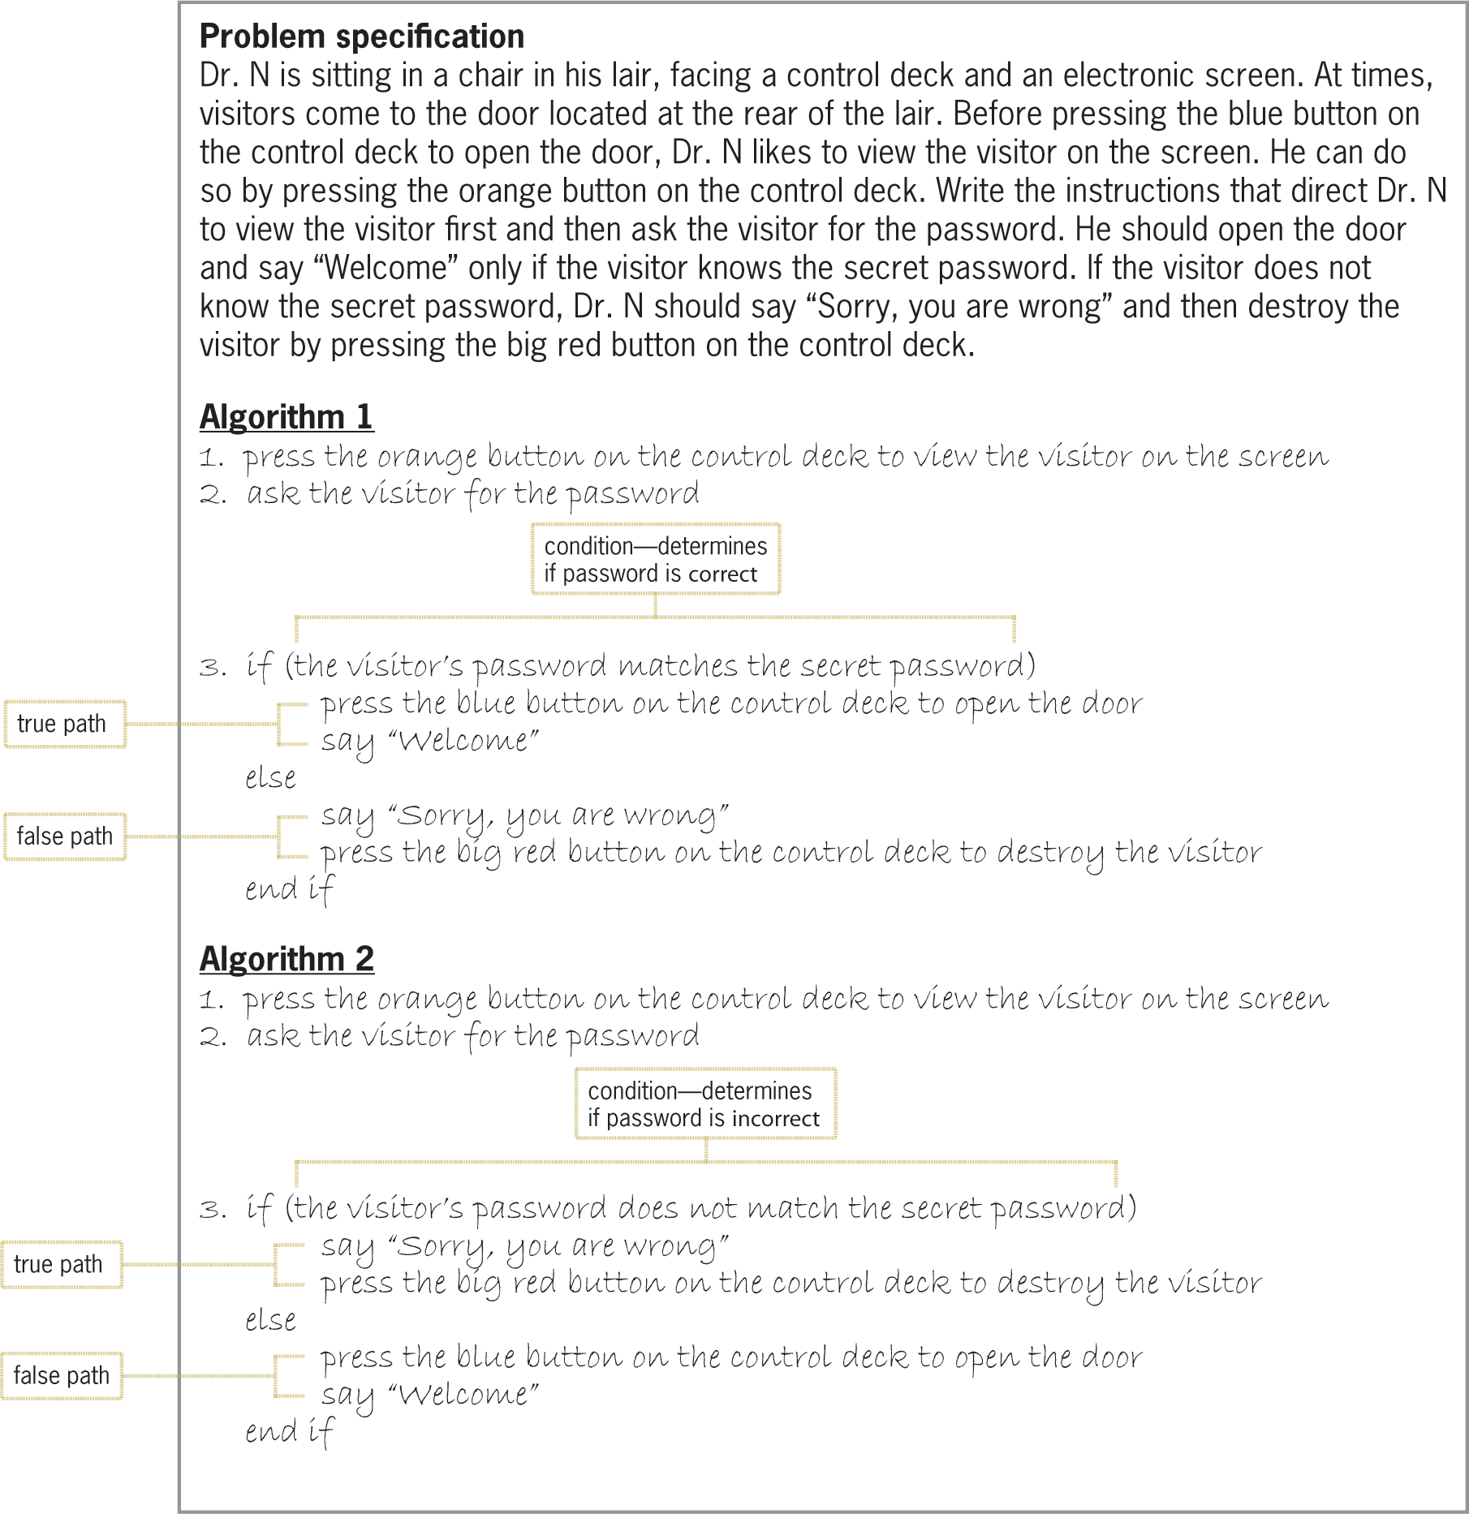
Making Decisions (cont’d.)
Figure 5-3 A problem that requires the sequence
structure and a dual-alternative selection structure

Slide 8
Flowcharting a Selection Structure
Recall from Chapter 2:
Oval = start/stop symbol; rectangle = process symbol; parallelogram = input/output symbol
Diamond symbol is called decision symbol
Used to represent condition (decision) in selection and repetition structures
Selection structures have one flowline leading in and two leading out
“T” line leading out points to true path
“F” line leading out points to false path

Slide 9
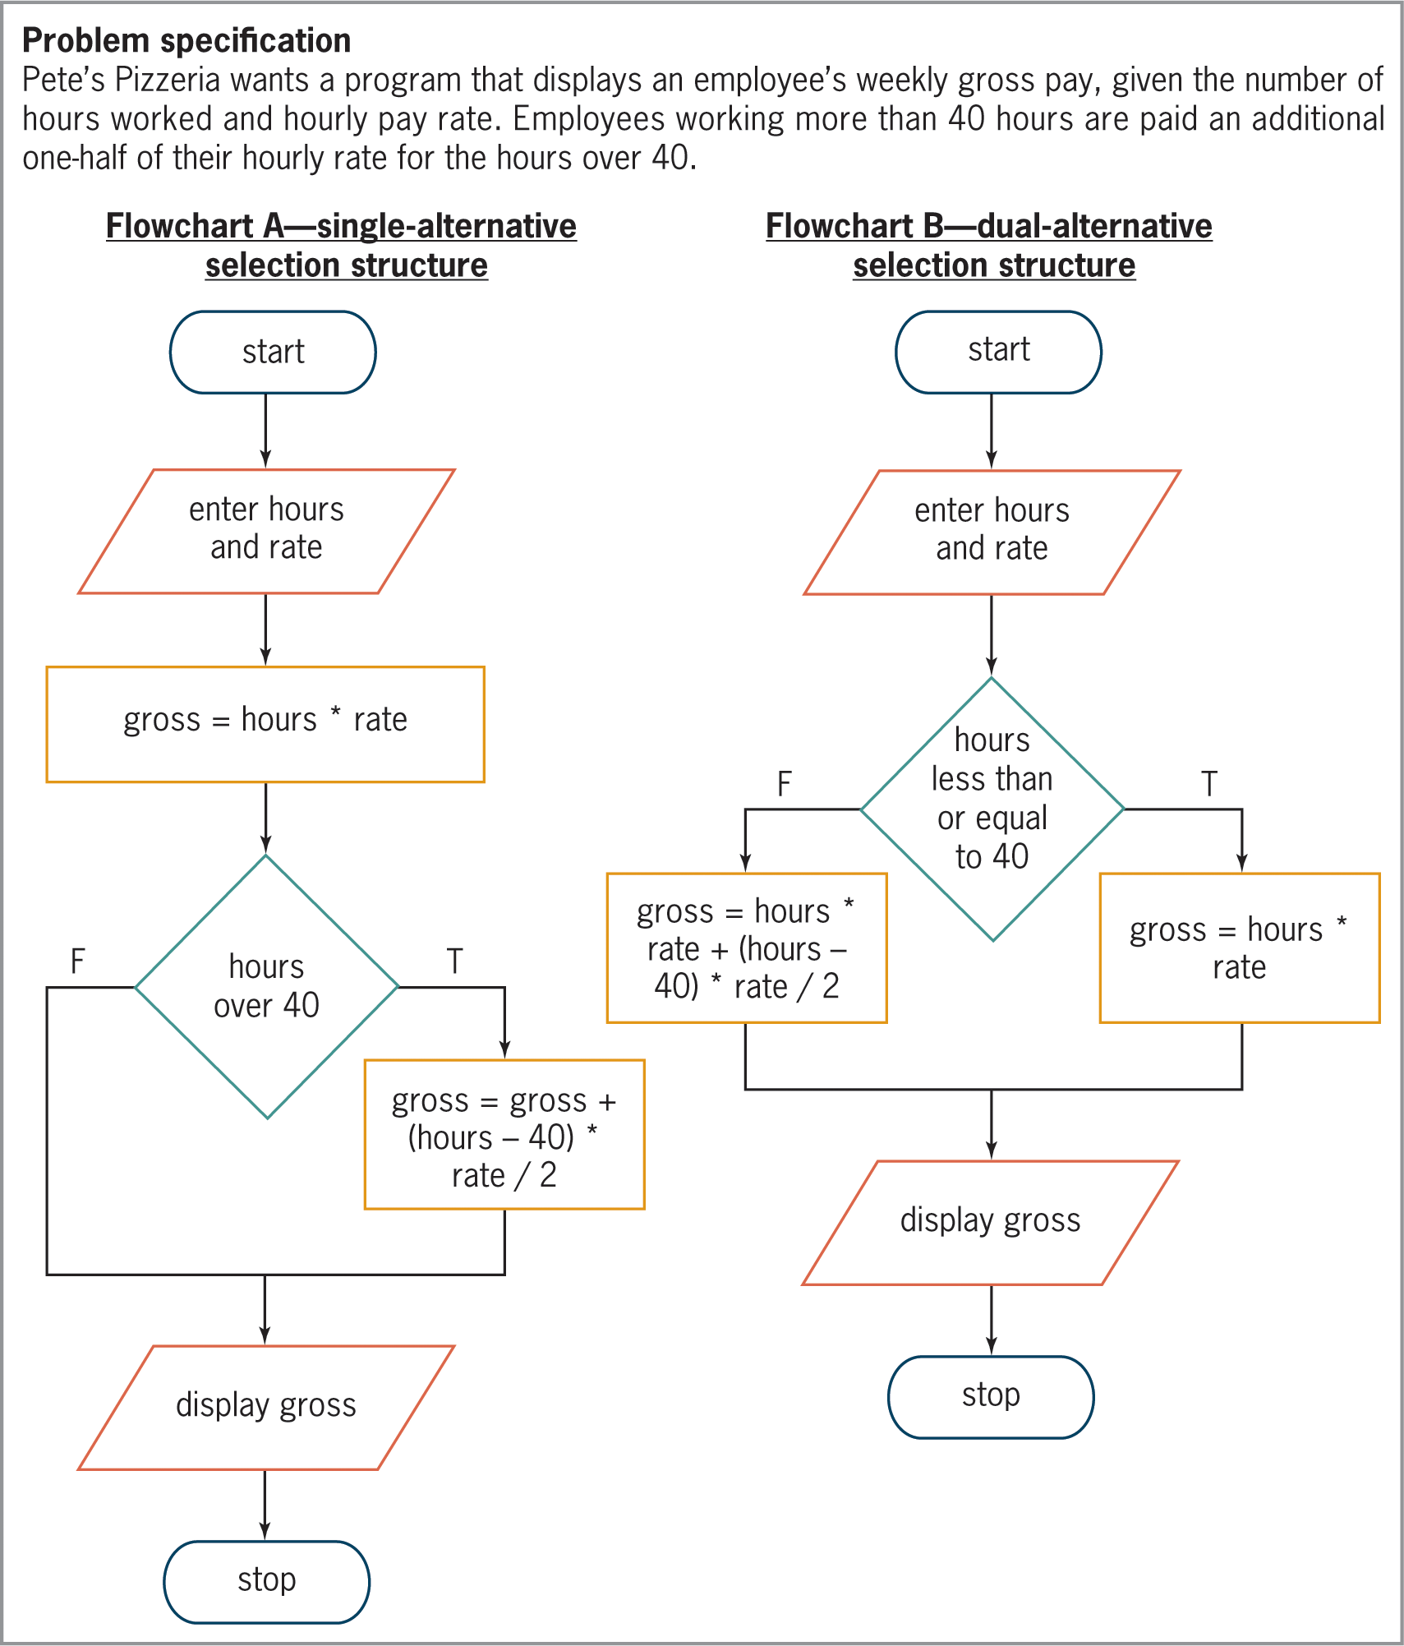
Flowcharting a Selection Structure (cont’d)
Figure 5-4 Problem specification and two correct algorithms in
flowchart form

Slide 10
Coding a Selection Structure in C++
The if (and else) statement is used to code most selection structures in C++
Syntax
if (condition)
one or more statements (true path)
[else
one or more statements (false path)]
Keyword if and condition are required
Portion in brackets (else clause) is optional
Only used for dual-alternative selection structures

Slide 11
Coding a Selection Structure in C++ (cont’d.)
Programmer must supply condition and statements in true (and, optionally, false) path
If path contains more than one statement, must be entered as a statement block (enclosed in {})
Good programming practice to put comment at end of clause (example: //end if)
Makes program easier to read and understand
The condition must be a Boolean expression
May contain variables, constants, arithmetic operators, comparison operators, and logical operators

Slide 12
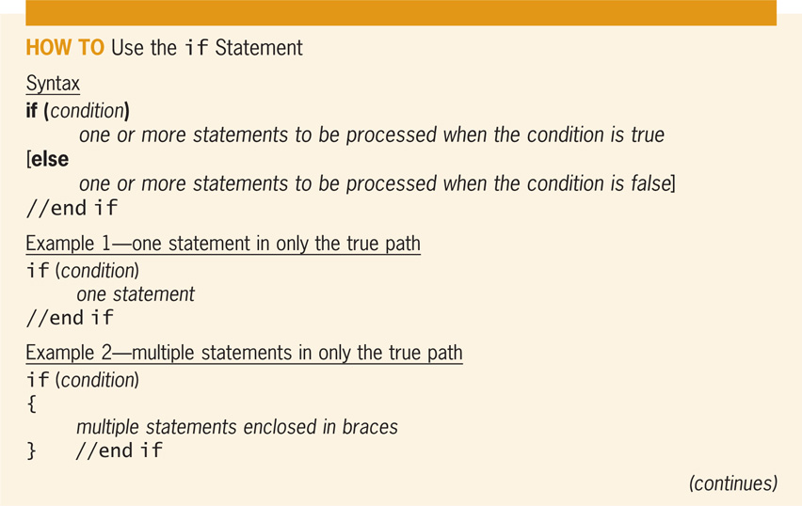
Coding a Selection Structure in C++ (cont’d.)
Figure 5-5 How to use the if statement

Slide 13
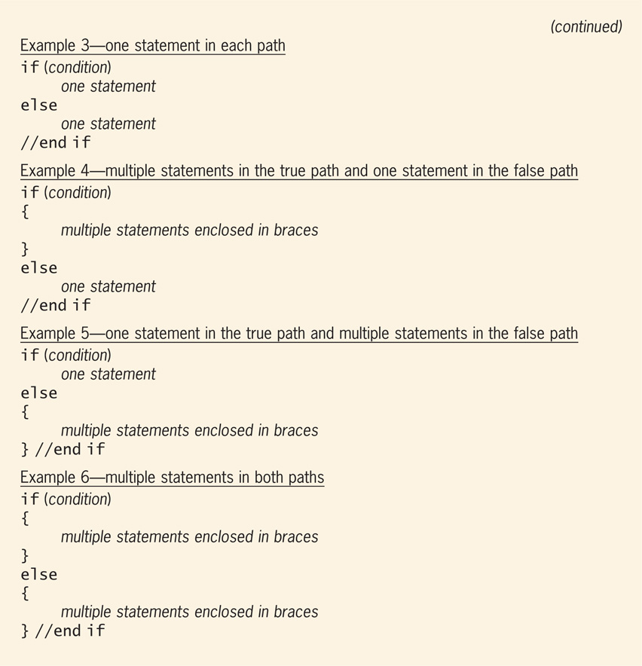
Coding a Selection Structure in C++ (cont’d.)
Figure 5-5 How to use the if statement (cont’d)

Slide 14
Comparison Operators
Comparison operators are used to compare two values that have the same data type
less than (<)
less than or equal to (<=)
greater than (>)
greater than or equal to (>=)
equal to (==)
not equal to (!=)
No spaces between dual-character symbols

Slide 15
Comparison Operators (cont’d.)
Have precedence numbers like arithmetic operators
<, <=, >, and >= have precedence value 1
== and != have precedence value 2
Lower precedence evaluated first
Equal precedence evaluated left to right
Parentheses used to override precedence order

Slide 16
Comparison Operators (cont’d.)
Expressions with comparison operators always evaluate to Boolean values
Don’t confuse equality operator (==) with assignment operator (=)
Don’t use equality (==) or inequality operator (!=) to compare real numbers
Real numbers cannot be stored exactly
Instead, test that absolute value of their difference is within some small threshold

Slide 17
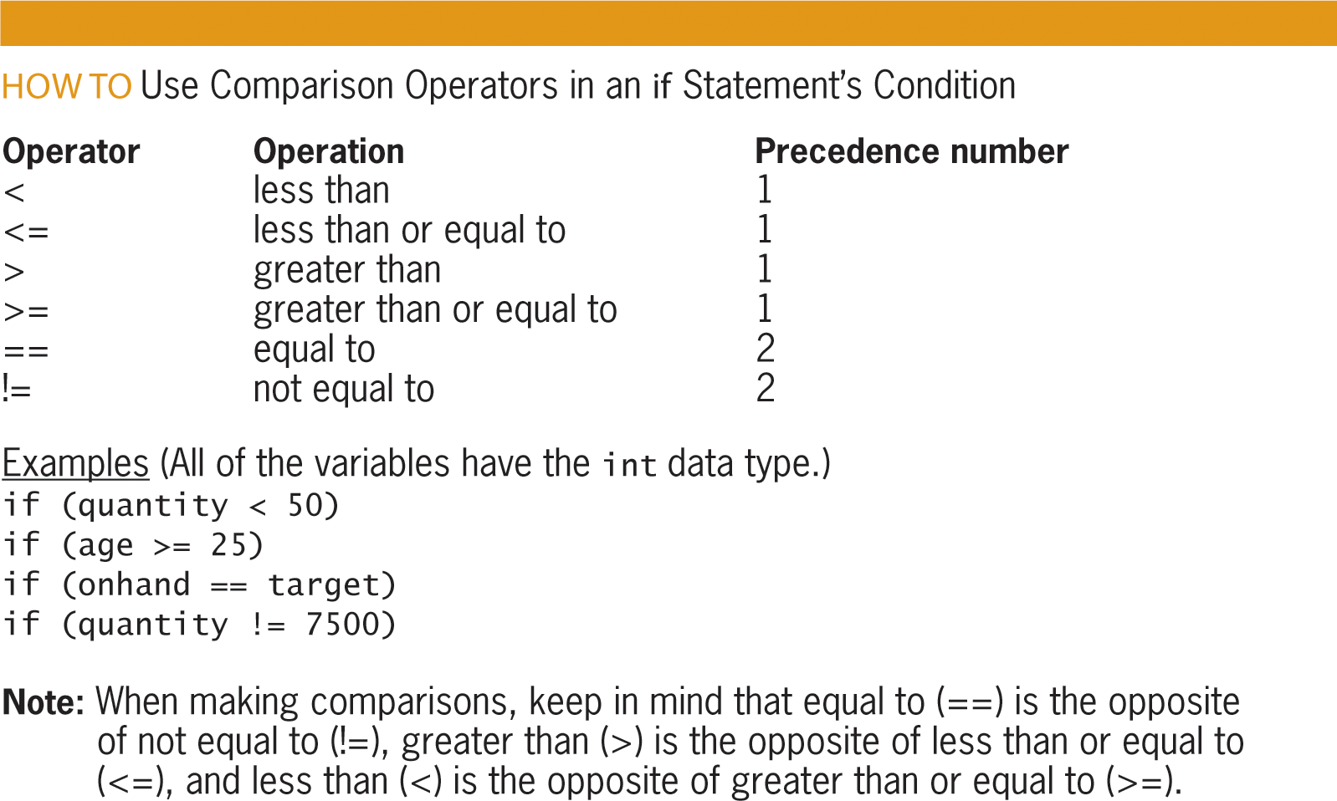
Comparison Operators (cont’d.)
Figure 5-6 How to use comparison operators
in an if statement’s condition

Slide 18
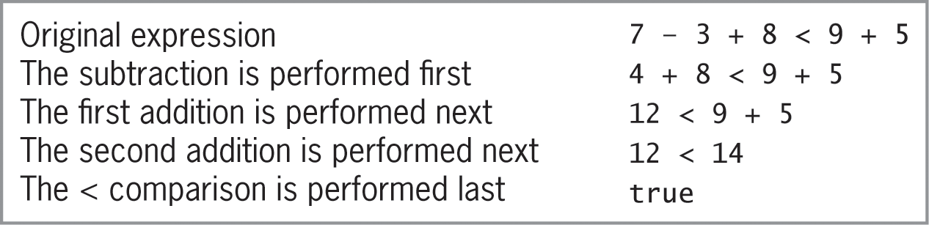
Comparison Operators (cont’d.)
Figure 5-7 Evaluation steps for an expression containing
arithmetic and comparison operators

Slide 19
Swapping Numeric Values
Example program (next slide) takes in two integers, swaps them if first is greater, and then prints out lower number, followed by higher number
Uses single-alternative selection structure with statement block in true path
Creates temporary variable to accomplish swap
Temp variable can only be used in statement block in which it is declared; called a local variable

Slide 20
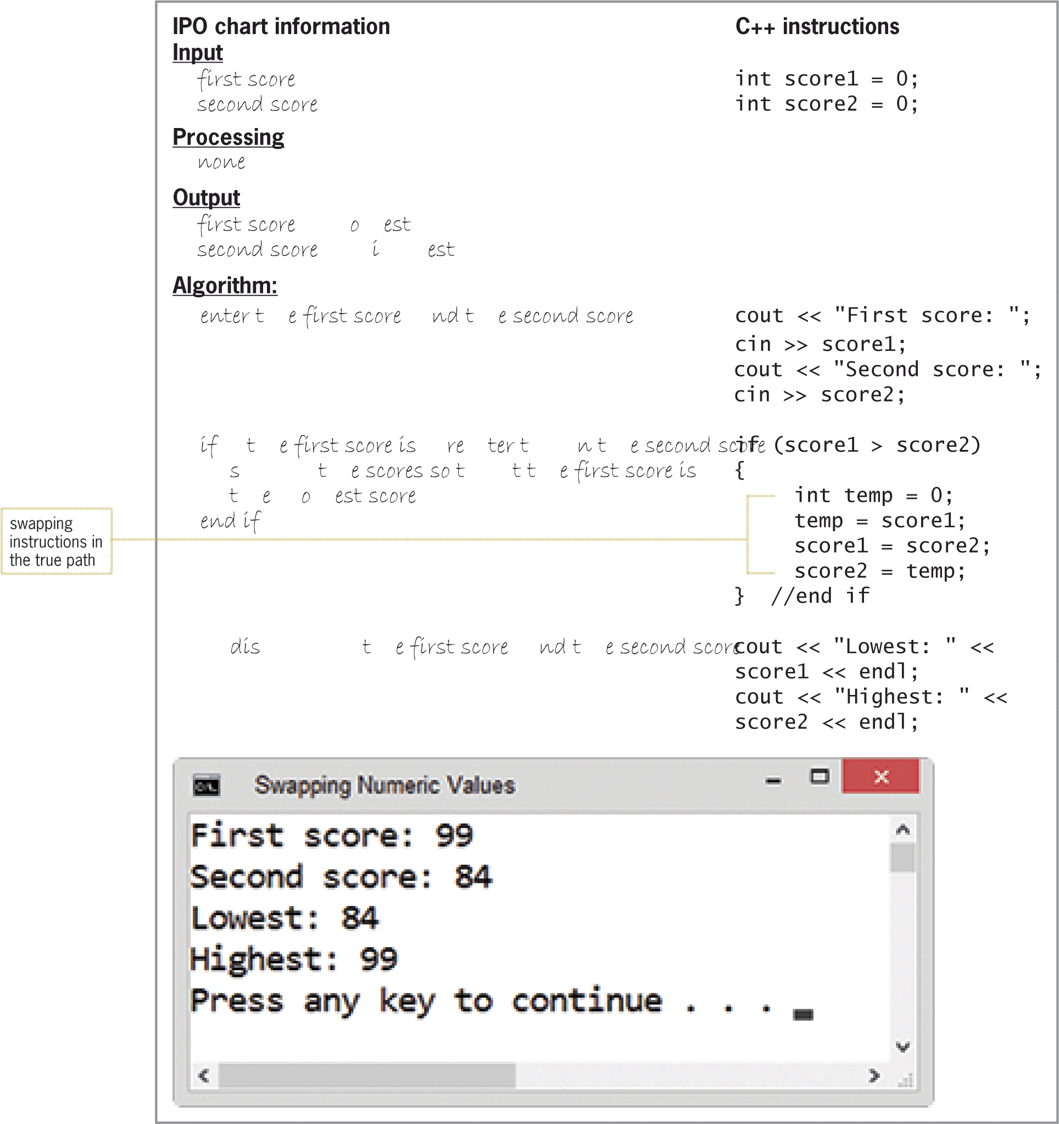
Swapping Numeric Values (cont’d.)
Figure 5-8 Swapping program

Slide 21
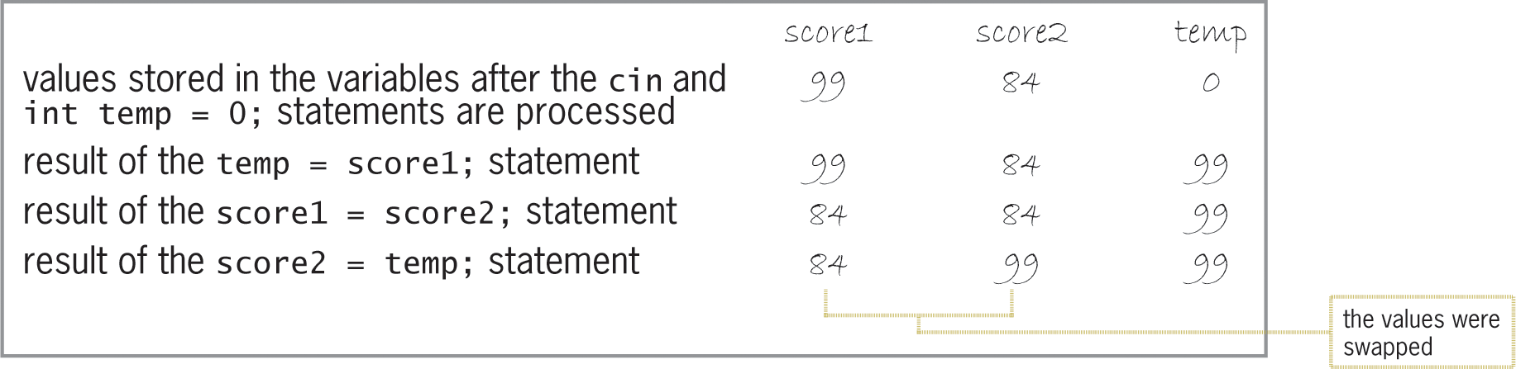
Swapping Numeric Values (cont’d.)
Figure 5-9 Illustration of the swapping concept

Slide 22
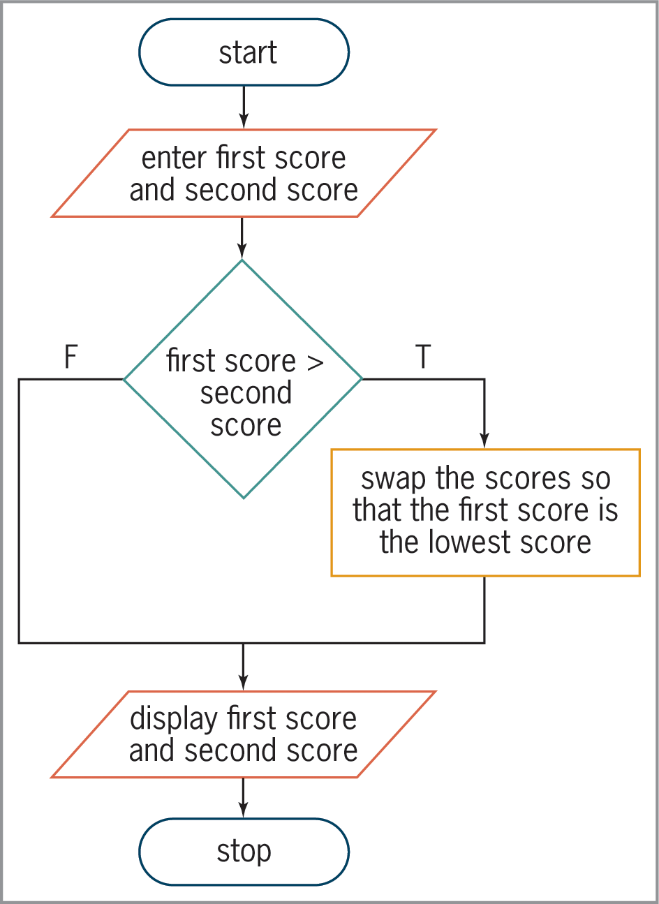
Swapping Numeric Values (cont’d.)
Figure 5-10 Flowchart for the swapping program

Slide 23
Displaying the Area or Circumference
Example program (next slide) displays the area or circumference of a circle given the radius
Choice of area or circumference is selected by user
Uses a dual-alternative selection structure

Slide 24
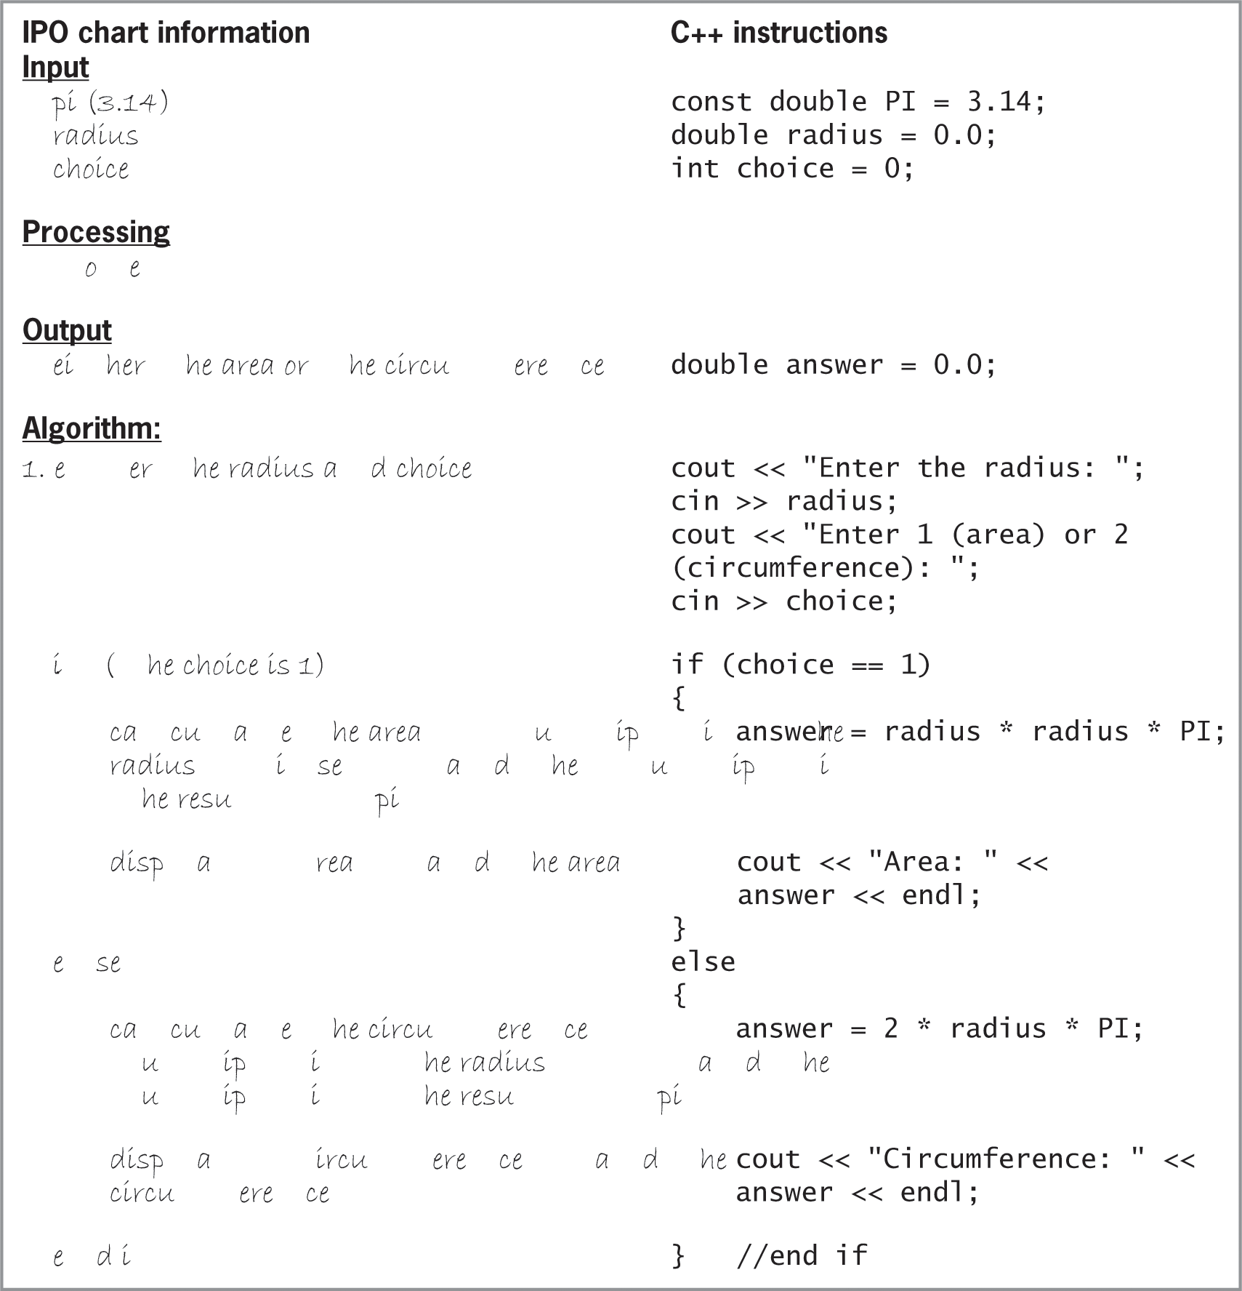
Displaying the Area or Circumference (cont’d.)
Figure 5-11 IPO chart information and C++
instructions for the area or circumference program

Slide 25
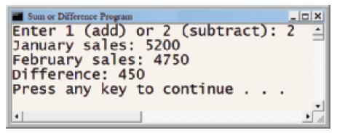
Displaying the Area or Circumference (cont’d.)
Figure 5-11 Sample run of the area or circumference program

Slide 26
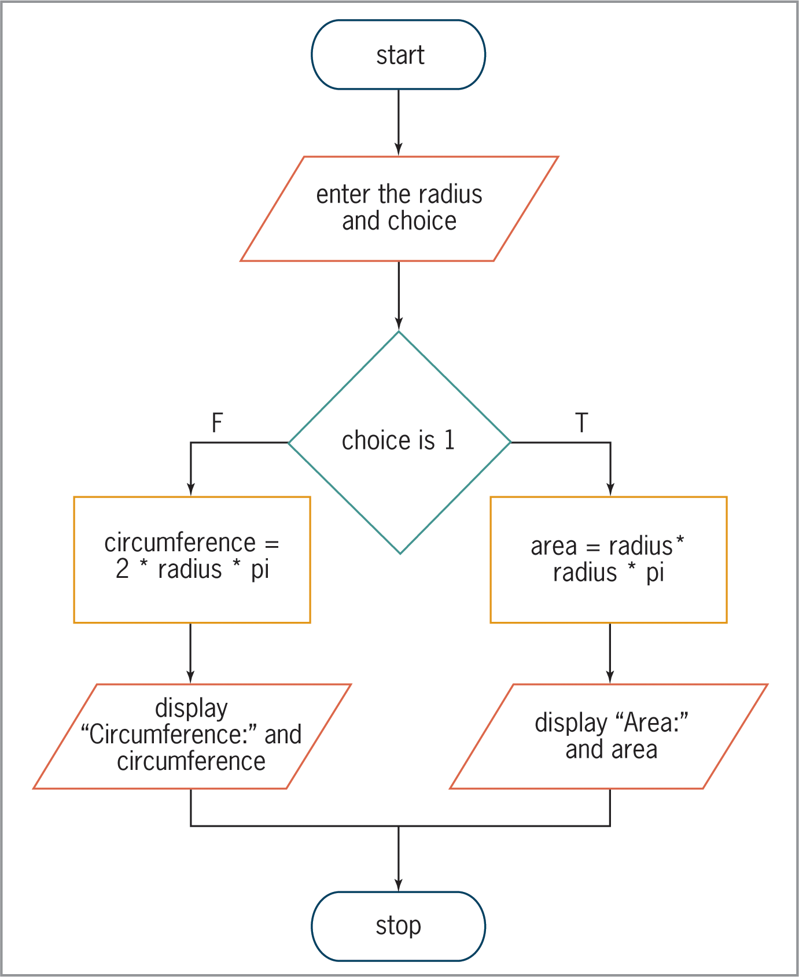
Displaying the Area or Circumference (cont’d.)
Figure 5-12 Flowchart for area or circumference program

Slide 27
Logical Operators
Logical operators allow you to combine two or more conditions (sub-conditions) into one compound condition
Also called as Boolean operators (always evaluate to true or false)
Two most common are And (&&) and Or (||)
All sub-conditions must be true for a compound condition using And to be true
Only one of the sub-conditions must be true for a compound condition using Or to be true

Slide 28
Logical Operators (cont’d.)
And evaluated before Or in an expression
Logical operators evaluated after arithmetic and comparison operators
Parentheses can override precedence ordering
Truth tables summarize how computer evaluates logical operators
Only necessary sub-conditions are evaluated; called short-circuit evaluation
Example: if first sub-condition in an And clause is false, second sub-condition need not be evaluated

Slide 29
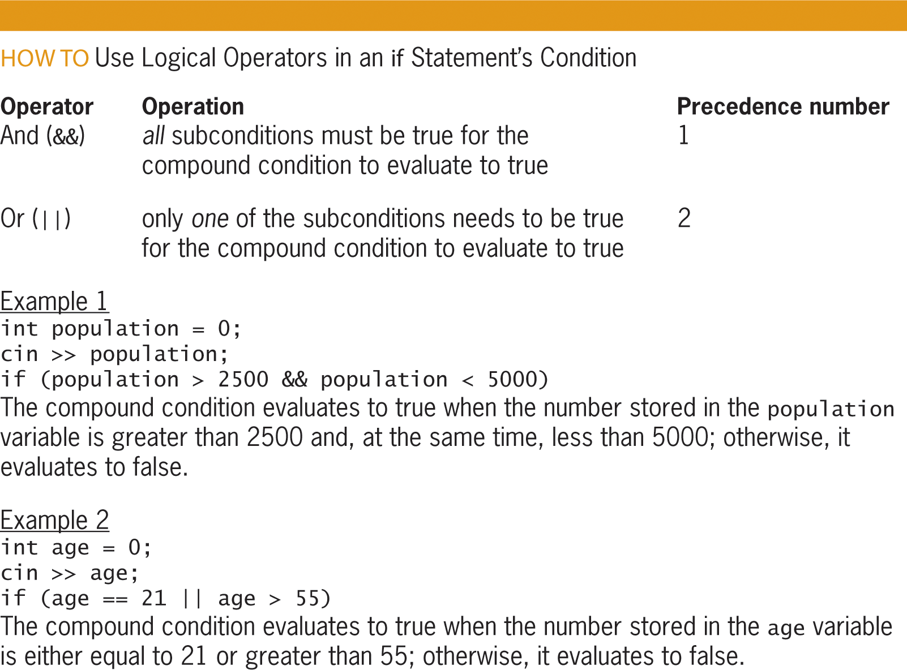
Logical Operators (cont’d.)
Figure 5-14 How to use logical operators in an if statement’s condition

Slide 30
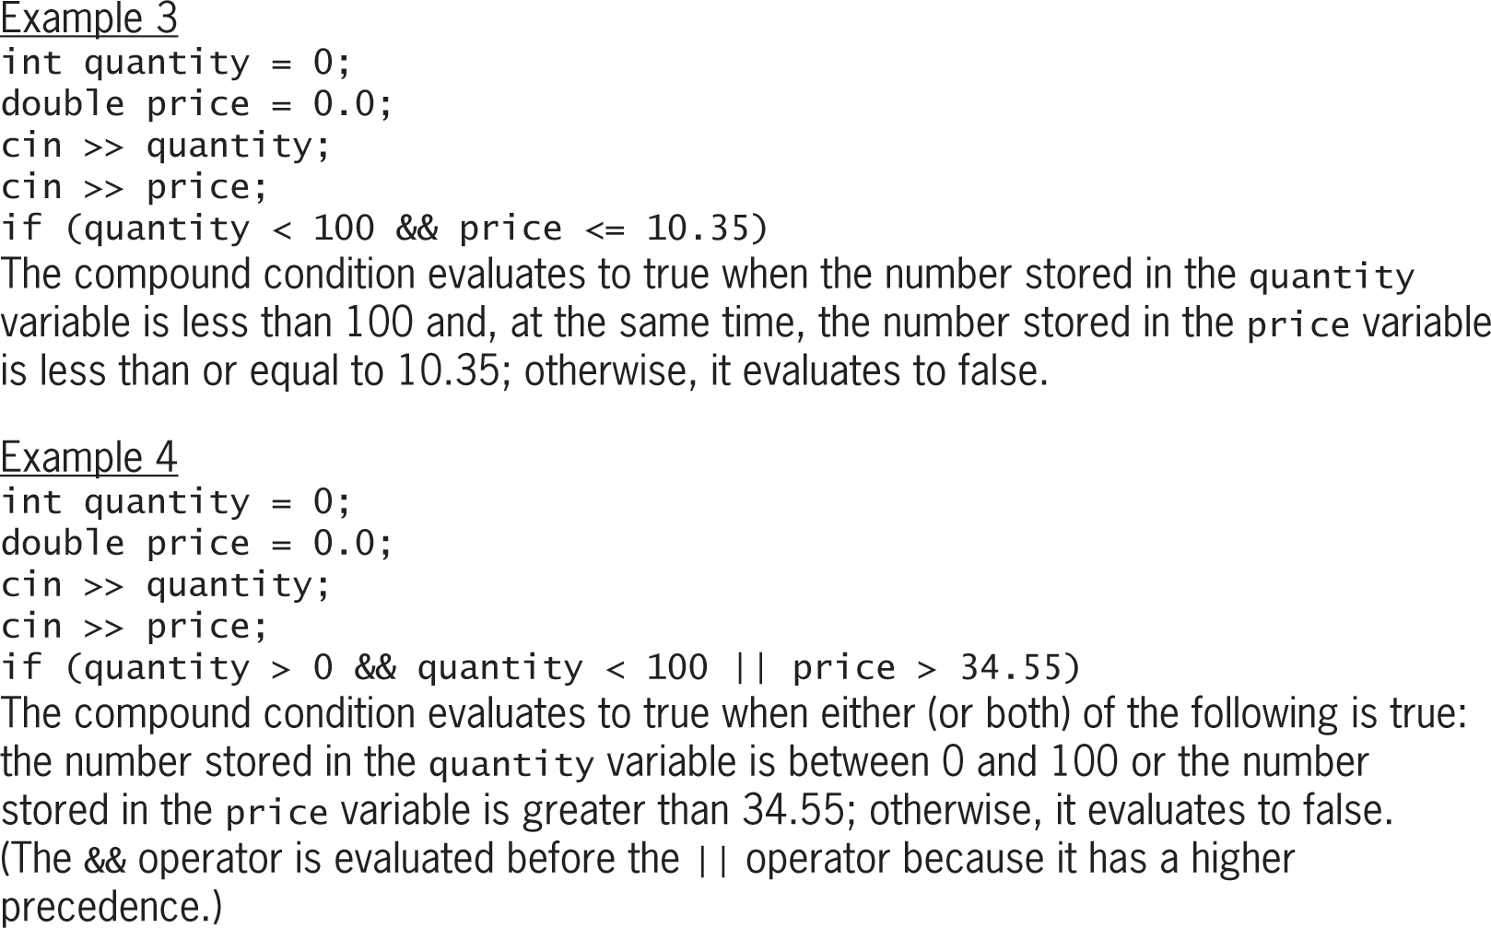
Logical Operators (cont’d.)
Figure 5-14 How to use logical operators in an if statement’s condition

Slide 31
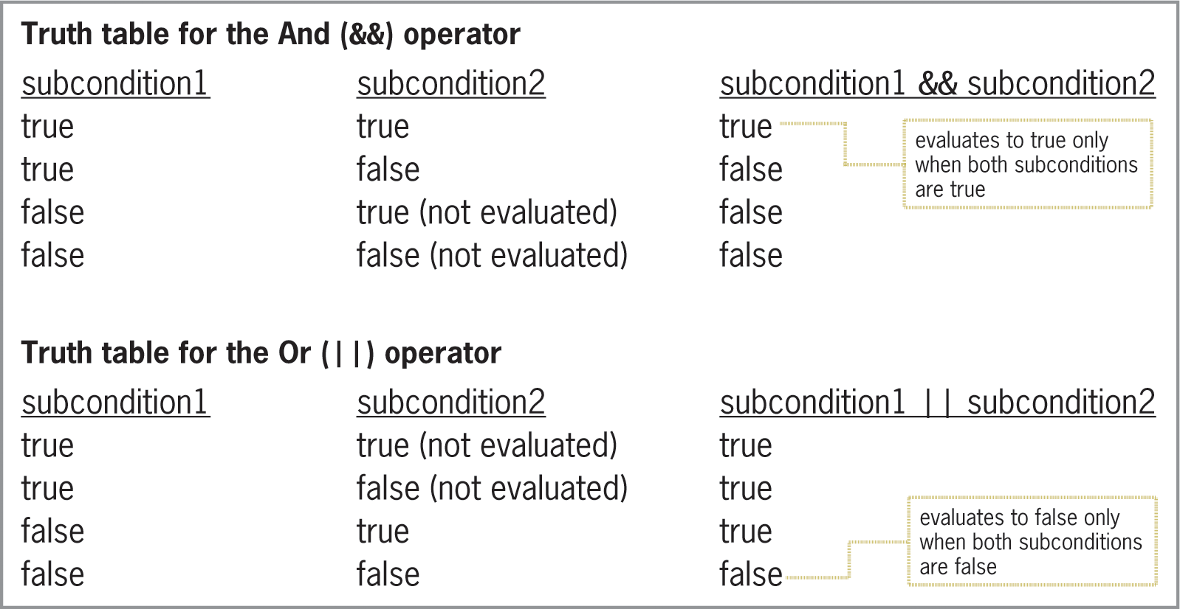
Logical Operators (cont’d.)
Figure 5-15 Truth tables for the logical operators

Slide 32
Using the Truth Tables
Two example problem descriptions are given, and truth tables for And and Or operators are used to find appropriate sub-conditions and logical operators
Calculate bonus for A-rated salespeople with monthly sales greater than $5000
rating == ‘A’ && sales > 5000
Send letter to all A-rated and B-rated salespeople
rating == ‘A’ || rating == ‘B’

Slide 33
Calculating Gross Pay
Example problem description is given in which the gross pay of an employee must be calculated
Program must verify that number of hours worked is between 0 and 40
Process of verifying that input data is within expected range is known as data validation
Program outputs gross pay if the number of hours worked is valid and is an error message otherwise

Slide 34
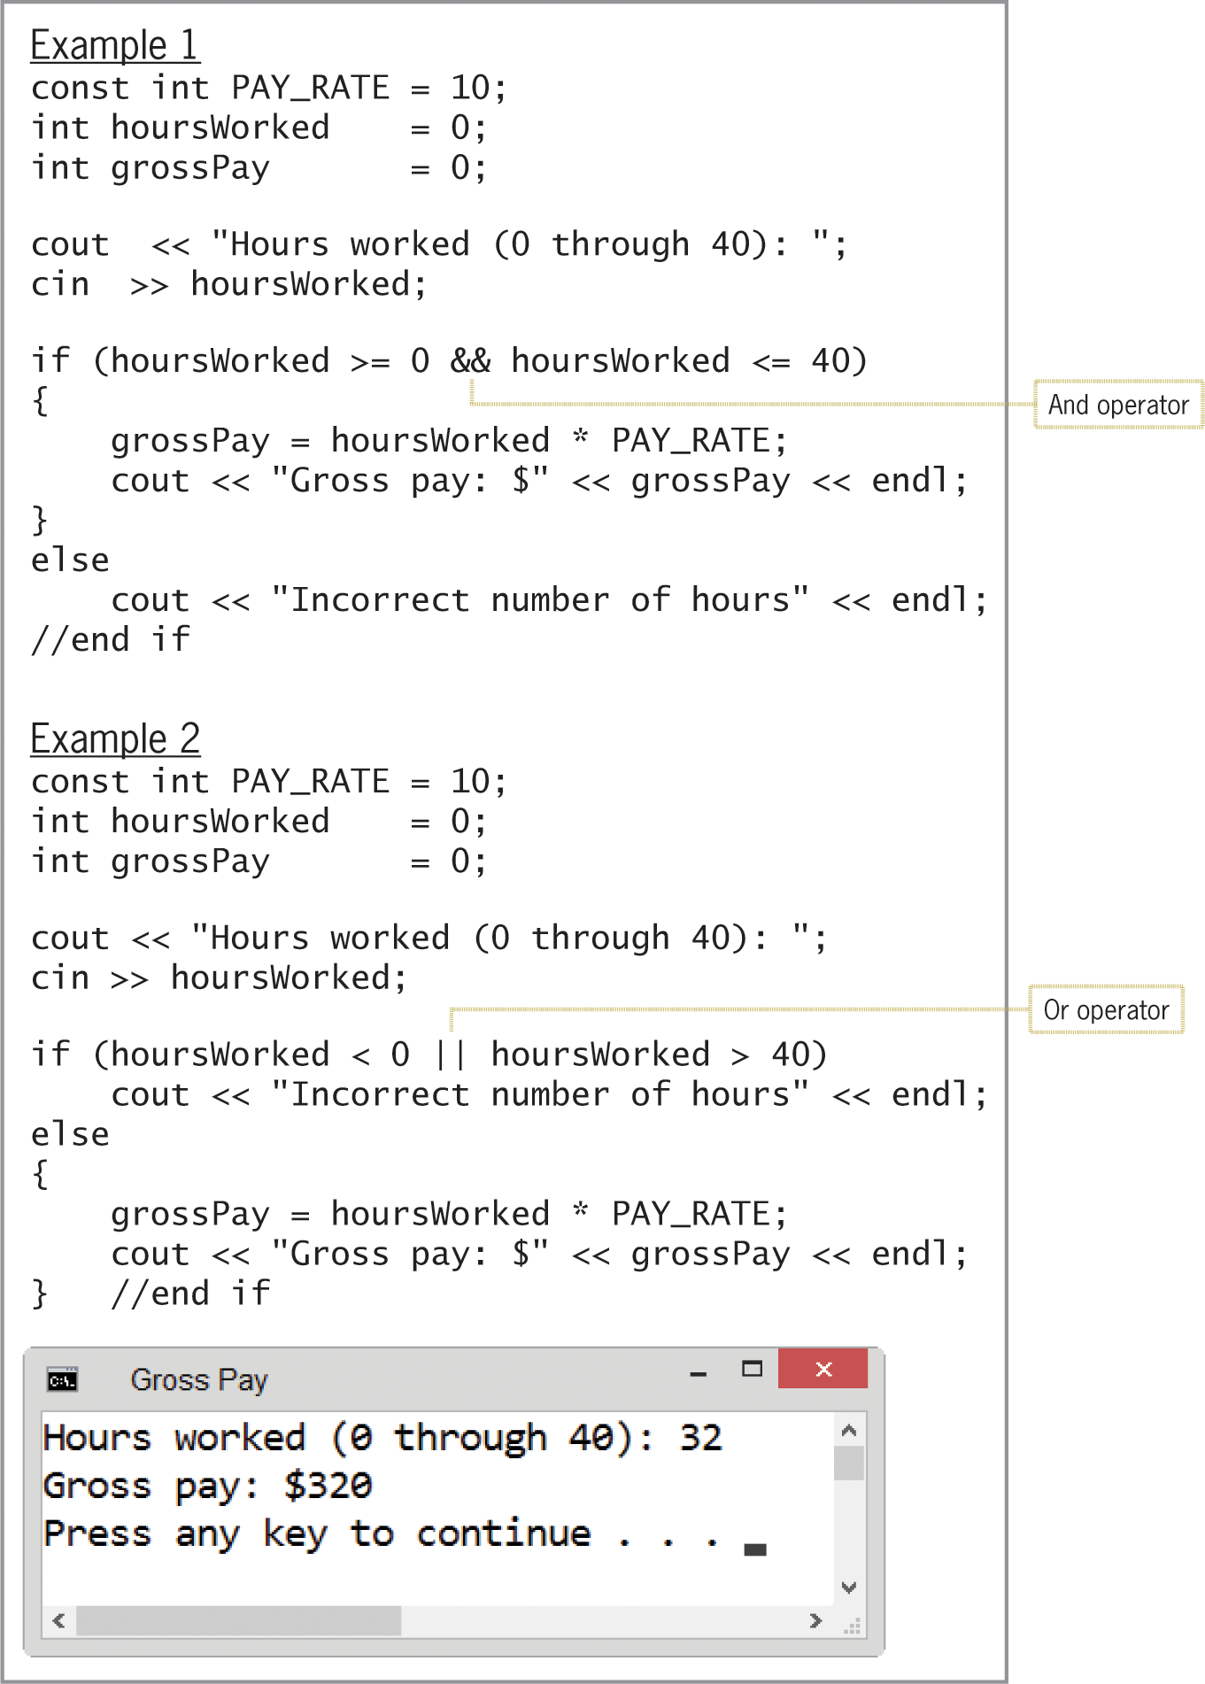
Calculating Gross Pay (cont’d.)
Figure 5-17 Gross Pay program

Slide 35
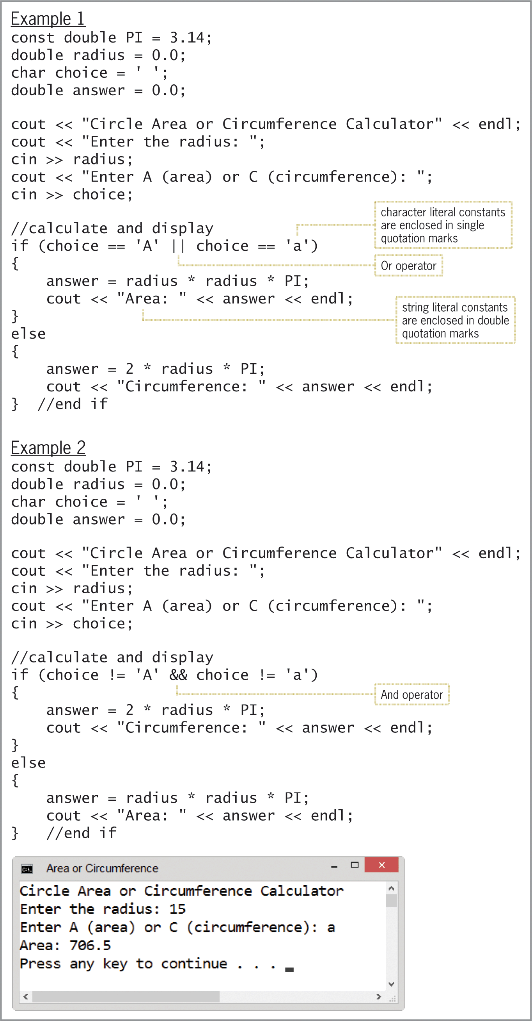
Different version of Area or Circumference program
Figure 5-18 Different version of Area or Circumference program

Slide 36
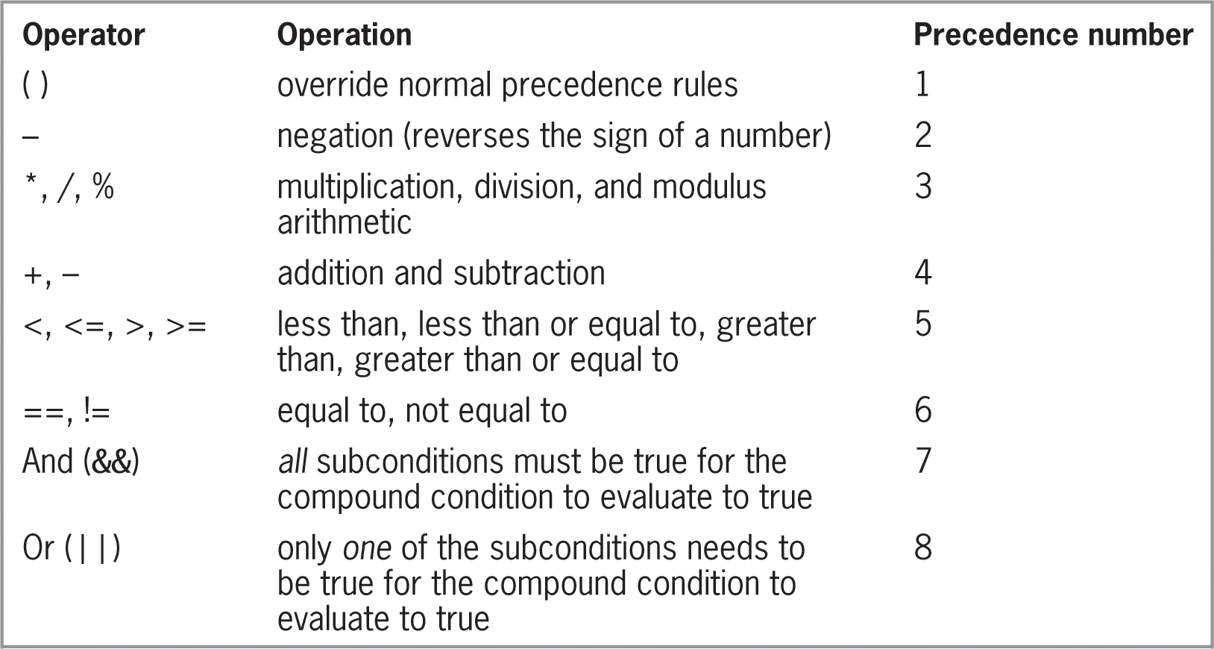
Summary of Operators
Figure 5-19 Listing and an example of
arithmetic, comparison, and logical operators

Slide 37
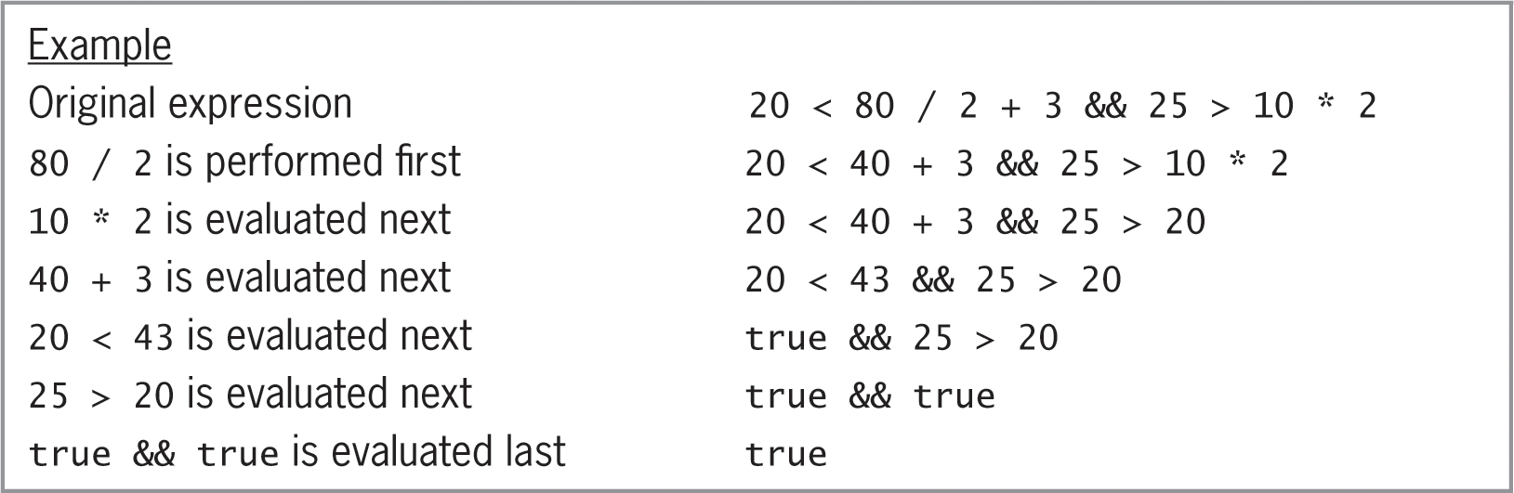
Summary of Operators (cont’d.)
Figure 5-19 Listing and an example of
arithmetic, comparison, and logical operators

Slide 38
Converting a Character to Uppercase or Lowercase
toupper and tolower functions used to convert characters between uppercase and lowercase
toupper function temporarily converts a character to uppercase; tolower function temporarily converts a character to lowercase
Syntax is toupper(charVariable) and tolower(charVariable)
Item between parentheses in a function’s syntax is called an argument – information the function needs to perform its task

Slide 39
Converting a Character to Uppercase or Lowercase (cont’d.)
Each function copies the character in its argument to a temporary location in internal memory, converts the character to the appropriate case, and returns the temporary character
Neither function changes the contents of its argument, but rather, changes the temporary variable

Slide 40
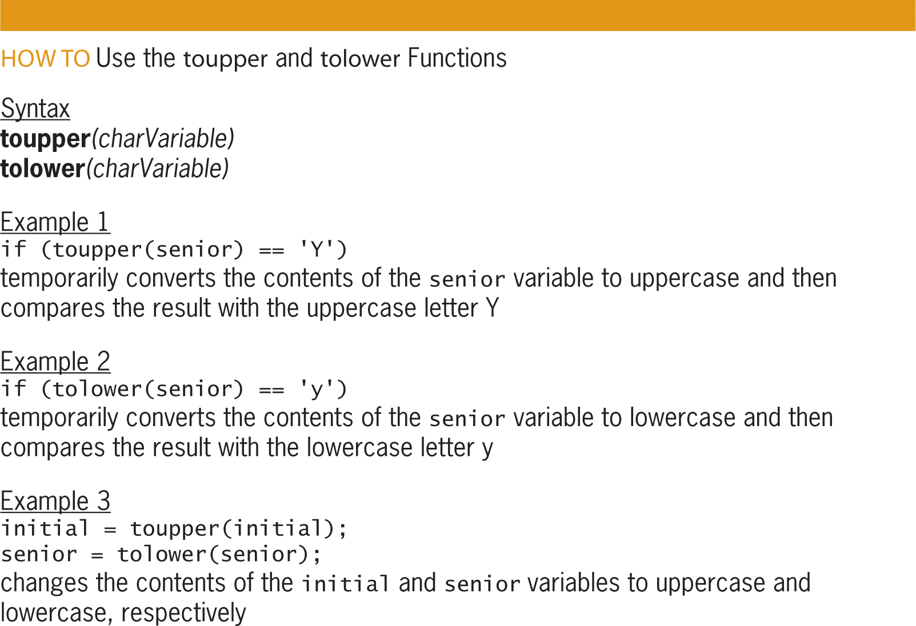
Converting a Character to Uppercase or Lowercase (cont’d.)
Figure 5-20 How to use the toupper and tolower functions

Slide 41
Formatting Numeric Output
Real numbers are displayed in either fixed-point or scientific (e) notation
Small real numbers (six or less digits before decimal place) displayed in fixed-point notation
Example: 1,234.56 displayed as 1234.560000
Large real numbers (more than six digits before decimal place) displayed in e notation
Example: 1,225,000.00 displayed as 1.225e+006
Purpose of program determines appropriate format

Slide 42
Formatting Numeric Output (cont’d.)
Stream manipulators allow control over formatting
fixed stream manipulator displays real numbers in fixed-point notation
scientific stream manipulator displays real numbers in e notation
Stream manipulator must appear in a cout statement before numbers you want formatted
Manipulator can appear by itself in a cout statement or can be included with other information

Slide 43
Formatting Numeric Output (cont’d.)
Manipulator remains in effect until end of program execution or until another manipulator is processed
Numbers formatted with fixed stream manipulator always have six numbers to the right of the decimal place
Number is padded with zeros if there aren’t six digits
Example: 123.456 is displayed as 123.456000
Number is rounded and truncated if there are more than six digits
Example: 123.3456789 is displayed as 123.345679

Slide 44
Formatting Numeric Output (cont’d.)
setprecision stream manipulator controls number of decimal places
Syntax setprecision(numberOfDecimalPlaces)
You can include setprecision and fixed manipulators in the same cout statement
Definition of setprecision manipulator contained in iomanip file
Program must contain #include <iomanip> directive to use setprecision manipulator

Slide 45
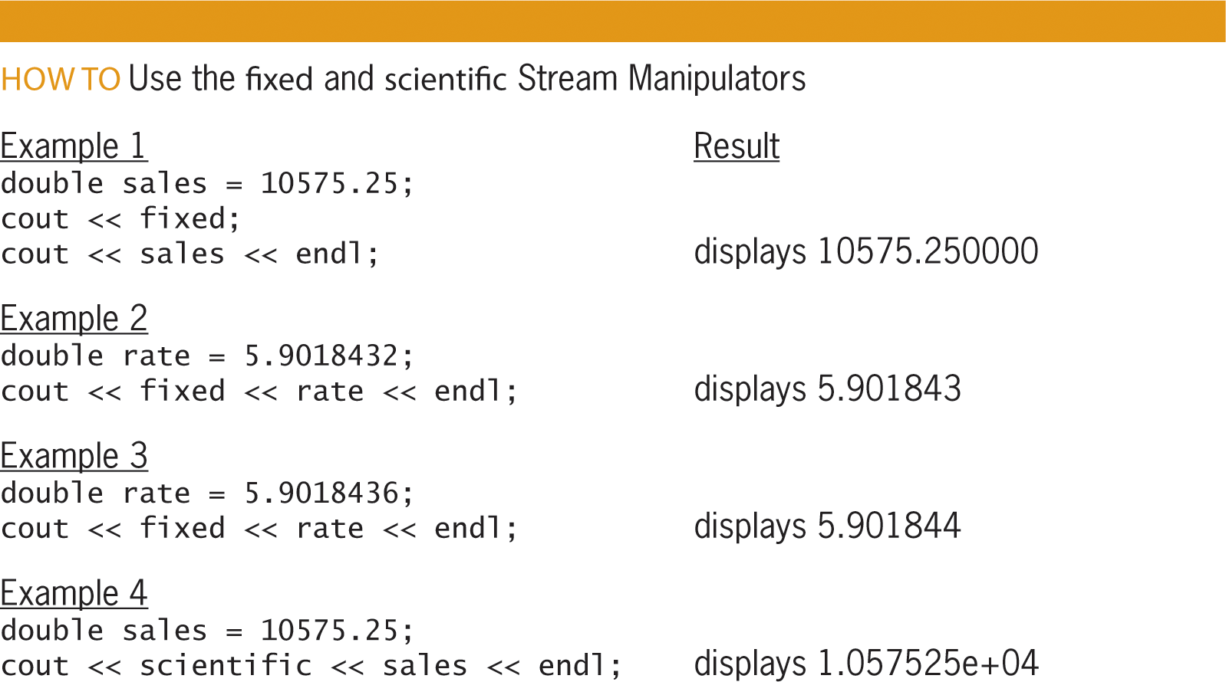
Formatting Numeric Output (cont’d.)
Figure 5-21 How to use the fixed
and scientific stream manipulators

Slide 46
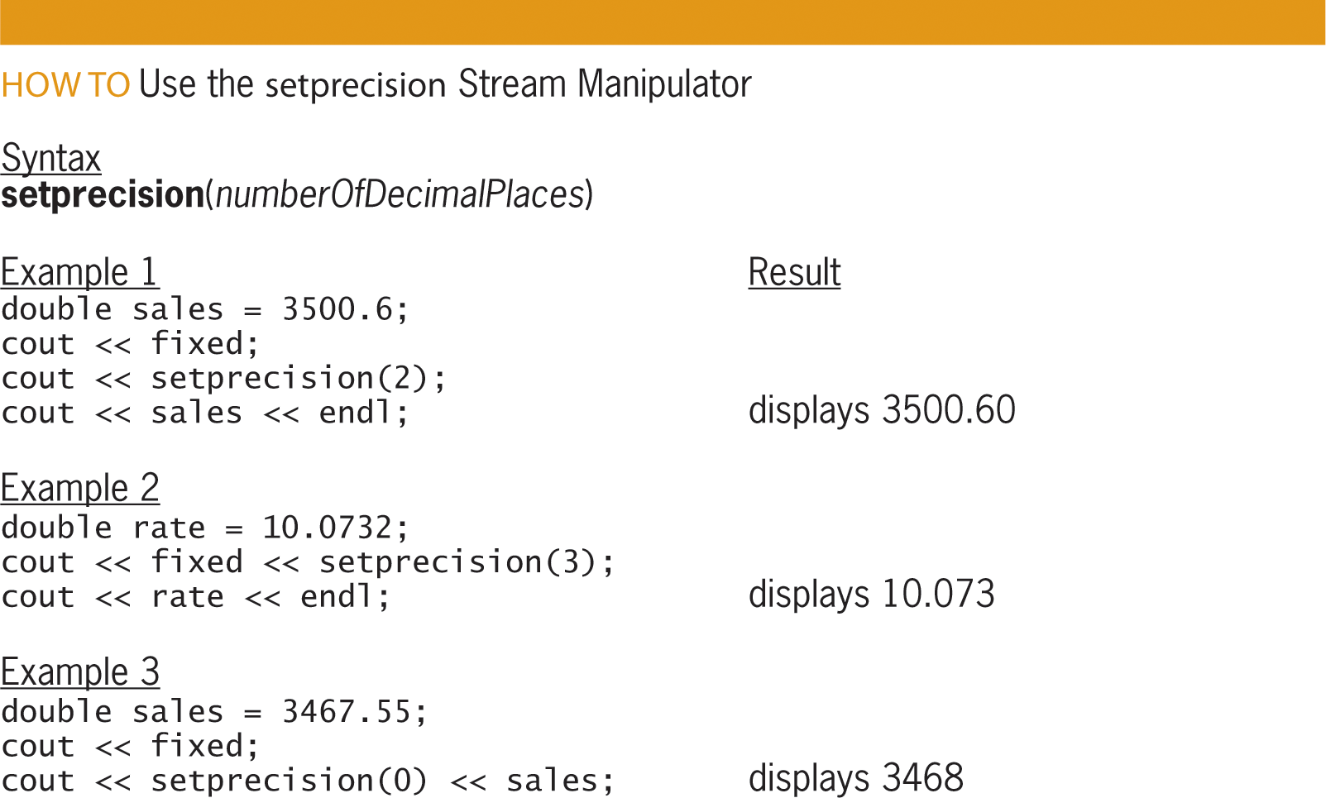
Formatting Numeric Output (cont’d.)
Figure 5-22 How to use the setprecision stream manipulator

Slide 47
Summary
Selection structure used when you want a program to make a decision before choosing next instruction
Selection structure’s condition must evaluate to true or false
In single-alternative and dual-alternative selection structures, the instructions followed when the condition is true are placed in the true path
In dual-alternative selection structures, the instructions followed when the condition is false are placed in the false path

Slide 48
Summary (cont’d.)
A diamond (decision symbol) is used to represent a selection structure’s condition in a flowchart
Each selection structure has one flowline going into the diamond and two coming out (“T” line represents the true path, and “F” line the false path)
The if statement is used to code most selection structures
True or false paths with more than one statement must be entered as a statement block (enclosed in {})

Slide 49
Summary (cont’d.)
Good practice to end if and else statements with a comment (//end if)
Comparison operators are used to compare values – Expressions using them evaluate to true or false
Comparison operators have precedence ordering similar to arithmetic operators
Don’t use == and != to compare real numbers
Local variables can only be used in the statement block in which they are declared

Slide 50
Summary (cont’d.)
Expressions with logical operators evaluate to true or false
And (&&) and Or (||) are logical operators, which also have precedence
Arithmetic operators are evaluated first in an expression, followed by comparison operators and then logical operators
Character comparisons are case sensitive
toupper and tolower functions temporarily convert a character to upper or lowercase

Slide 51
Summary (cont’d.)
The fixed and scientific stream manipulators allow you to format real numbers
The setprecision manipulator allows you to specify the number of decimal places that appear
fixed and scientific are defined in the iostream file
setprecision is defined in the iomanip file

Slide 52
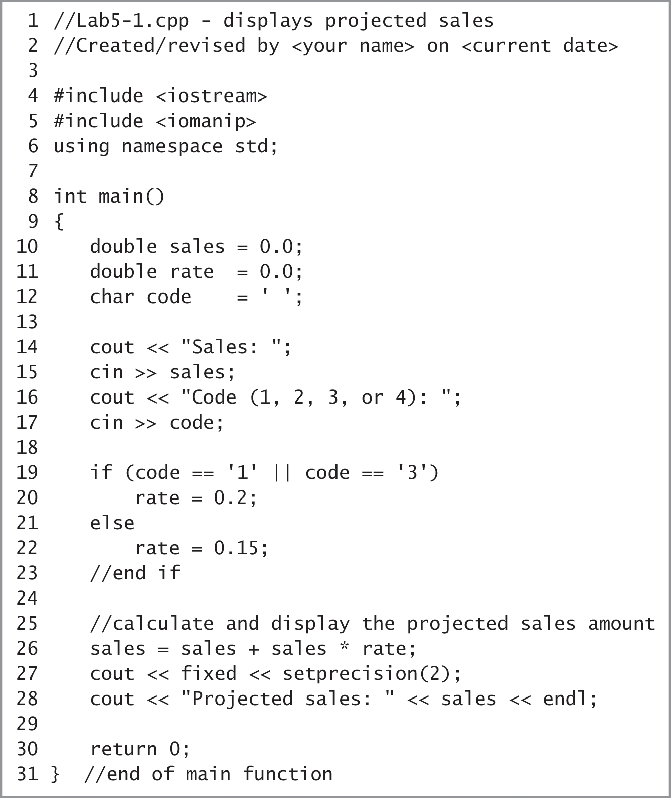
Lab 5-1: Stop and Analyze
Figure 5-23 Program for Lab 5-1

Slide 53
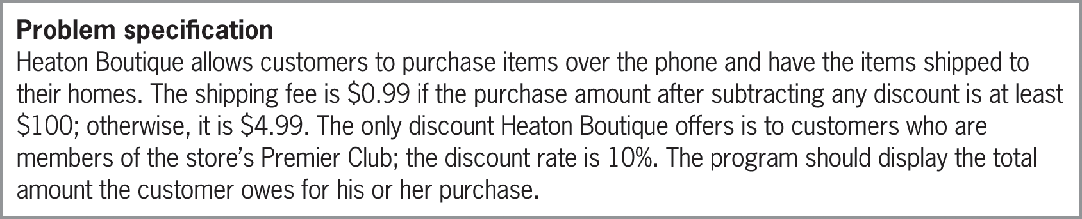
Lab 5-2: Plan and Create
Plan and create an algorithm for the Heaton Boutique problem below
Figure 5-24 Problem specification for Lab 5-2

Slide 54
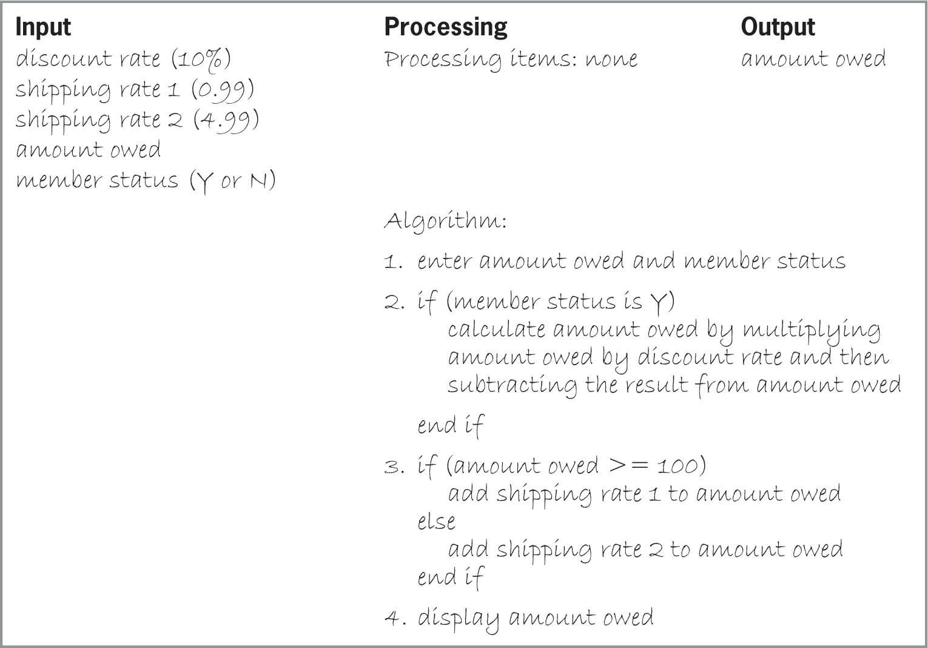
Lab 5-2: Plan and Create (cont’d.)
Figure 5-25 Completed IPO chart for the Heaton Boutique program

Slide 55
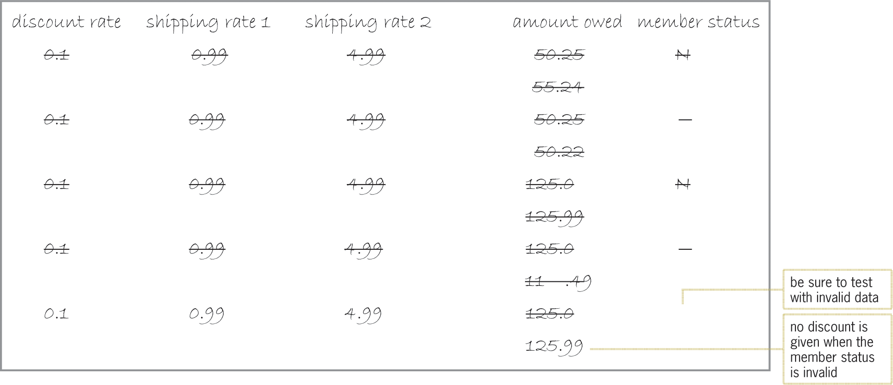
Lab 5-2: Plan and Create (cont’d.)
Figure 5-26 Completed desk-check table for the Heaton Boutique algorithm

Slide 56
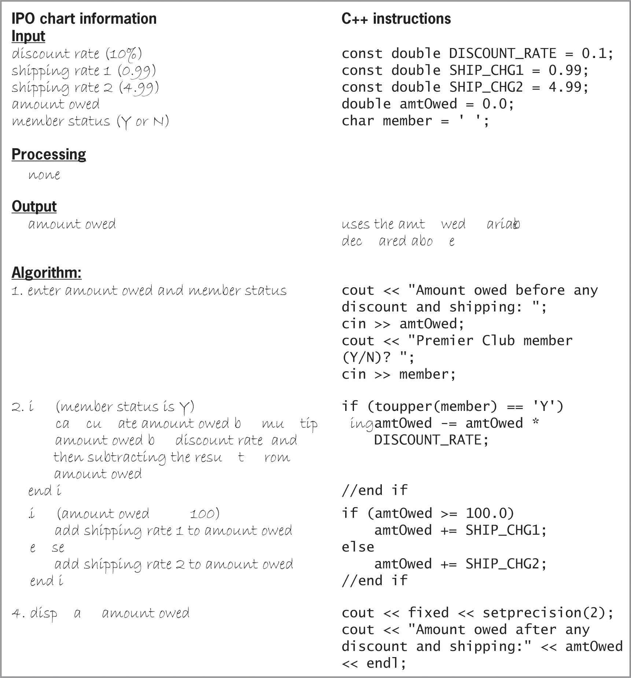
Lab 5-2: Plan and Create (cont’d.)
Figure 5-27 IPO chart information and C++ instructions for the Heaton Boutique problem

Slide 57
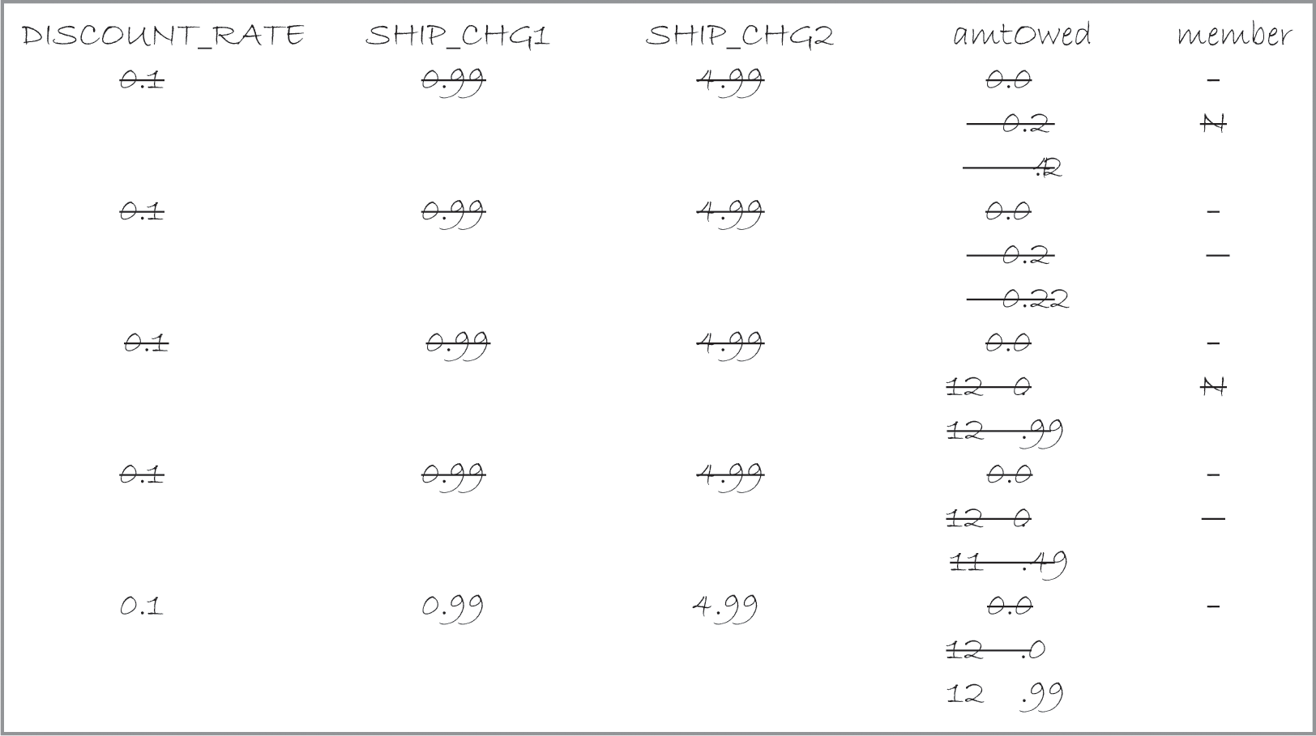
Lab 5-2: Plan and Create (cont’d.)
Figure 5-28 Completed desk-check table for the Heaton Boutique program

Slide 58
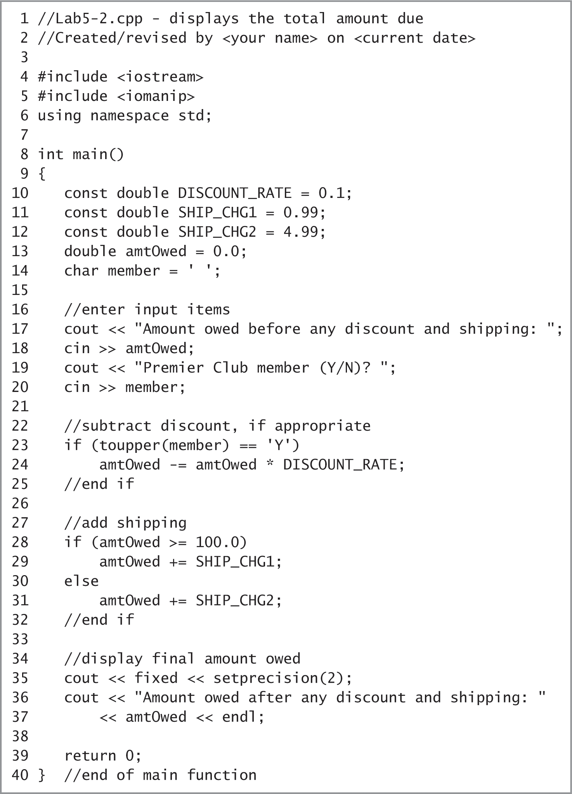
Lab 5-2: Plan and Create (cont’d.)
Figure 5-29 Heaton Boutique program

Slide 59
Lab 5-3: Modify
Modify the Heaton Boutique program from Lab 5-2 to give a 10% discount to members of the store’s Premier Club, and a 5% discount to all other customers.

Slide 60
Lab 5-4: What’s Missing?
The program in this lab should display the total price of the tickets purchased by a customer. A maximum number of 10 tickets can be purchased.
Put the C++ instructions in the proper order, and then determine the one or more missing instructions.
Test the program three times using the following data: 8, 12, and -3.

Slide 61
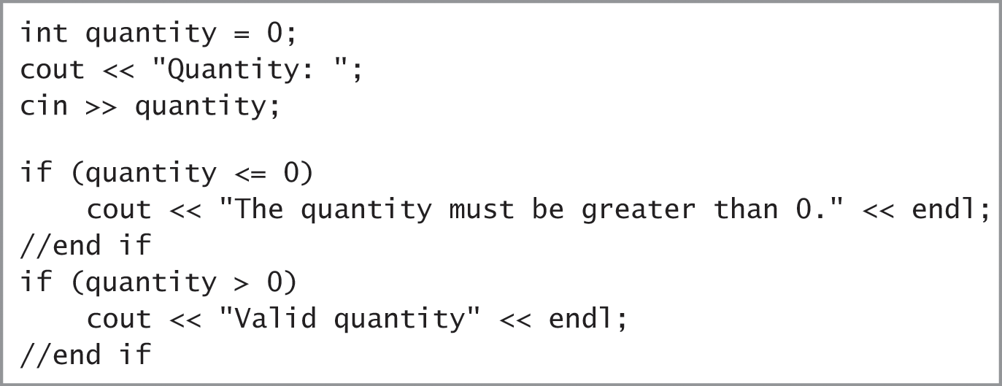
Lab 5-5: Desk-Check
Desk-check the code shown in Figure 5-30 using the numbers 5 and 0.
Although the code displays the appropriate message, is it considered efficient?
How can you make the code more efficient?
Figure 5-30 Code for Lab 5-5

Slide 62
Lab 5-6: Debug
Follow the instructions for starting C++ and opening the Ch05-Lab5-6.cpp file.
Test the program using codes 1, 2, and 3. Use 100 as the purchase price.
Debug the program.

